Slide 1

How does environmental identity contribute to empathy with people and nature?
Nartova-Bochaver Sofya,
Irkhin Boris
Higher School of Economics, Moscow, Russia
3rd WORLD CONFERENCE ON PERSONALITY
April, 2-6,2019, Hanoi, Vietnam

Slide 2
Sound theories
Reverence for Life theory by Albert Schweitzer (1987)
Deep Ecology by Arne Næss (1989)
Biophilia hypothesis by E.O. Wilson (1984)
Theory of Environmental Identity by Susan Clayton (2003)
Theory of basic human values by Sh. Schwarz (1992)
Theory of Moral expansiveness by Dan Crimston et al. (2016)

Slide 3
Familiar concepts
Ecological self (Deep Ecology, Næss & Rothenber, 1989):
Through the process of self-actualisation, one transcends the limits of the individuated "egoistic" self and arrives at a position of an ecological self. Hence, ecological self stimulates environmentally responsible behavior, which, in turn, can be considered a form of altruism.

Slide 4
Familiar concepts
Environmental identity (Gottfredson & Holland, 1996):
EID is a human resemblance to one or more physical and social settings in society, congruence between people vocational and educational (not natural!) environments. It is a term of organizational psychology.

Slide 5
Environmental identity in our study
EID is “the establishment of a personal sense of connection to the natural environment which is based on history, similarity and feelings of personal connection”; a self-concept that demonstrates the extent to which people perceive themselves as part of nature, incorporated in it and defined by it (Clayton, 2003).

Slide 6
Environmental identity in our study
A sense of environmental identity is fundamentally a recognition of one’s own interdependence with a larger collective. It is a personal identity that also has implications for social connections; it should thus be related to other, perhaps non-environmental, perspectives and attitudes that emphasize connections and the larger group.
It is one of the multitude of people’s identities (along with physical, social, gender, ethnic, etc.).

Slide 7
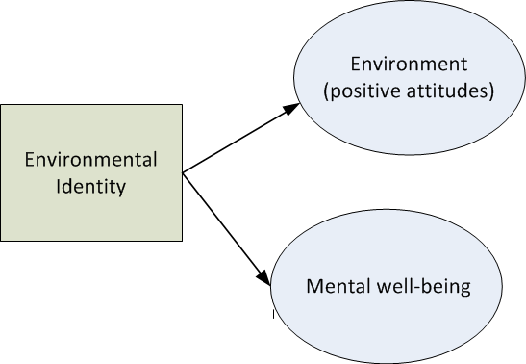
Predictive role of EID

Slide 8
EID and pro-environmental attitudes
Protecting the pro-environmental motivation and activism (Matsuba et al., 2012)
Gardening, including pro-environmental gardening behavior, engagement with natural processes, and an overall sense of gardening identity (Kiesling and Manning, 2010)
Sense of self-efficacy about the possibility of effecting environmental change (Clayton et al. 2014)
And so on…

Slide 9
EID and well-being
Well-being in a broad sense (Hinds and Sparks, 2009)
Emotional, psychological and social well-being; as well as mindfulness (Howell et al. 2011)
Happiness, operationalized as life satisfaction, positive affect, and vitality (Capaldi et al., 2014)
Stress reduction and increase of attention (Mayer et al., 2009)
And so on…

Slide 10
But what about other people?

Slide 11
Why do we expect EID to be connected with empathy?
EID as a sort of self-expansion
motivates people for a desire for a larger sense of self,
“cultivating a larger identity” that transcends egoism,
emotions of awe and humility,
more concern about other people and inclination toward spiritual experiences (Wolsko and Lindberg, 2013; Hoot and Friedman, 2011).

Slide 12
Why do we expect EID to be connected with empathy?
Empathy is the understanding and sharing of another person’s emotional experience (Davis, 1983;Hoffman,2008)
It is a key to altruism and intergroup harmony (e.g.,Eisenberg & Miller,1987;Stephen & Finlay, 1999)
Lack of results showing connection between EID and pro-social and moral attitudes.

Slide 13
Research question
Does a sense of belonging to the natural world necessarily mean recognition and respect for other people or it may happen that it defines preference for nature only?

Slide 14
The current study
Aim: to study the connection between EID and empathy with nature and people.
Hypotheses:
EID is positively connected with empathy with nature and people
Its predictive role for empathy with nature is stronger than for social empathy.

Slide 15
Measures
Environmental Identity scale (EID, Clayton, 2003): “I think of myself as a part of nature, not separate from it”
Interpersonal Reactivity Index (IRI, Davis, 1983) - two of four subscales were used:
Perspective-taking: “When I'm upset at someone, I usually try to "put myself in his shoes" for a while”
Empathetic Concern: “I am often quite touched by things that I see happen”

Slide 16
Measures
Dispositional Empathy with Nature scale (DENS, Stern et al. 1995) - two subscales:
Perspective-taking: “I imagine how I would feel if I were the suffering animals and plants”
Empathetic concern: “I feel as though I were one of the suffering animals and plants”

Slide 17
Sample
200 respondents (168 female, M_{age} = 22.5, SD_{age} = 6.2, 84% females).
Most of the individuals were undergraduate students from Russian universities (54%), 55 graduated from university (27.5%), and 37 completed high school (18.5%).
Data was gathered via online questionnaire platform 1ka.si.

Slide 18
Results

Slide 19
Connection (r_{s}) between EID, Environmental and Social Empathy
DENS Perspective-taking | DENS Empathetic Concern | IRI Perspective-taking | IRI Empathetic Concern
.47 | .51 | .26 | .29
Note. All connections are significant at p < .01

Slide 20
Predictive role of EID for environmental and social empathy
Measure | β | R² | F(1,198) | p
Environmental empathy | .77 | .33 | 96.41 | .000
Social empathy | .19 | .09 | 19.67 | .000

Slide 21
Conclusion
There is a significant correlation between EID and empathy with nature and people
Hypothesis 1 is confirmed.
Predictive role of EID for empathy with nature is stronger than for social empathy
Hypothesis 2 is confirmed.

Slide 22
Why is that?
The connection between EID and empathy seems to be non-linear. Hence, it may be mediated by personal experience of nature, personality traits or values. Coming back to the existence of other identities, including cultural, religious, and social ones, we can assume that, depending on the degree of schism between these identities, different types of personality will result, for example, tentatively Natural, Social, Universal, and Marginal (between culture and nature) types.

Slide 23
Limitations
The sample was not balanced by age, gender, and residence which is especially important for Russia as a rural country.
Design of the study was too easy and needs to be expanded by mediating variables, e.g., personality traits, values, gender, and well-being.

Slide 24
Thank you for your attention!
Cảm ơn bạn đã quan tâm!
S-nartova@yandex.ru

